Slide 1
Text Set Project Training
[Insert location here]
[Insert date here]
Notes:
This module was last updated on February 2016.

Slide 2
Essential Questions
How can we design and integrate expert packs* into curriculum to build student vocabulary, knowledge, and capacity to read independently?
What else do we need to learn and do for this work to be as powerful as possible for children?
*expert packs are text sets designed to be as much as possible student-directed experiences.

Slide 3
Goals of the Project
Address the need for developing a robust knowledge base for students via a volume of student reading – Standard 10
Collaborate and create needed resources
Create opportunity for publishers and educators to collaborate
Throw a spotlight on the vital role librarians play in CCSS
Investigate how to best include expert pack resources into literacy instruction

Slide 4
Outcomes
Develop a bank of expert packs to be available on Edmodo and www.achievethecore.org
Collect evidence of how expert packs are used and useful
Increase student vocabulary, knowledge, and capacity to read increasingly complex grade-level text

Slide 5
Essential Work
Understanding text sets come in many forms
Learning how to develop strong collections of text set materials
Figuring out minimum instructional supports to promote student self-sufficiency
Developing a sense of how to employ text sets within the curriculum

Slide 6
Text Set Project on Edmodo
Make a teacher account at www.edmodo.com
On the left side of home screen, it will say “Groups” under your name and picture. Click on the + next to “Groups” and choose “Join”.
Type in the group code: sma265
From your home screen, you should now see “Text Set Project” listed under “Groups”. Click on this tab.
Choose “Folders” from the left side of your screen.

Slide 7
Why Text Sets?
David Liben and Silas Kulkarni
dliben@studentsachieve.net
mliben@studentsachieve.net
www.achievethecore.org

Slide 8
Five Essential Studies
Hernandez 2011, “Double Jeopardy”
Lesnick et al 2010, “Reading on Grade Level in Third Grade: How Is it Related to High School Performance and College Enrollment?”
Fletcher and Lyon 1998, 74% of 3rd graders who read poorly will still be struggling in 9th grade.
Snow et al 1998, “A person who is not at least a modestly skilled reader by the end of third grade is quite unlikely to graduate from high school.”
Juel 1988, 1st grade reading scores are a “reliable predictor of later reading scores.”
Notes:
Hernandez 2011 from the Annie E. Casey Foundation showed that students that are not reading proficient by third grade are 4 times less likely to graduate from high school on time than students who are reading proficiently in 3rd grade.
These 5 studies all suggest that if you are not reading successfully by at least the third grade your chances of catching up are low. This is both distressing and puzzling. Why would scores so early be such a strong predictor of outcomes later?

Slide 9
Why?
How is it that tests so early can predict results so many years later?
What are we doing in schools that might be perpetuating these trends?
What are we not doing in schools that might be perpetuating these trends?
Why does the gap between struggling and proficient readers increase the longer they are in school?
Notes:
Give participants time to think on their own about each of these questions and to discuss or share out. In particular emphasis to them the point implied by the 4th question: the gap grows the longer students are in school.

Slide 10
What are not the causes?
Lack of critical thinking
Failure to know or use comprehension strategies
Failure to master the standards
Notes:
This slide can use more or less explanation based on the audience. Tell them that we are going to look at some research and illustrations to explore this question more thoroughly, but that it’s worth starting with some common sense.
Lack of critical thinking is not likely to be the issue for at least two reasons:
Third grade reading tests don’t do a terribly good job of testing critical thinking. Mostly they seem to be tests of simple recall or comprehension, yet they are still predicting a wide variety of future outcomes.
Students seem to be able to think critically about a wide variety of topics that interest them. They routinely make inferences, analyze, draw connections and synthesize when talking about their sports, their arts, their social lives. For example, how quickly are students able to infer your moods or predict your behavior based on subtle clues from just a look on your face. But as soon as you put a piece of paper with text in front of them they seem to suddenly lose their ability to think critically.
Failure to know or use comprehension strategies also doesn’t seem like the likely cause.
Comprehension strategies are a lot like critical thinking i.e. making inferences, asking questions, predicting. Again students seem to do these things a lot, just not about material in print.
We have spent at least a decade or more heavily focusing our instruction on comprehension strategies. In fact it’s one of the dominant focus points of American educational practice across the country. And yet it seems not to have had much impact on this problem at all. If comprehension strategies were the problem, our efforts would likely have improved the problem, but so far they haven’t, as evidenced by studies a decade or more apart showing very similar results.
Failure to master the standards is probably not the issue either.
Once again the standards are similar to comprehension strategies are similar to critical thinking.
Moreover, much of this research occurred before most states even had standards. In addition standards have varied widely across states, but these results are remarkably consistent across geography. The advent of nationwide standards-based reform in the 90’s to the 2000’s didn’t seem to change this relationship.
Quick turn and talk

Slide 11
Quick Quiz: Which is harder?
Notes:
So if none of those factors are the cause, what is? The next activity will help us start to get at the answer.
This is a simple quiz. I’m going to show you two questions, and I want you to tell me, which question is harder.

Slide 12
Question 1: Literal Meaning Low on Bloom’s Taxonomy
Restate the following sentence in your own words:
“The former render possible theoretical cognition according to principles a priori; the latter in respect of this theoretical cognition only supplies in itself a negative principle (that of mere contrast), but on the other hand it furnishes fundamental propositions which extend the sphere of the determination of the will and are therefore called practical.”
Notes:
Read slide.
Emphasize that restating or paraphrasing is a very low-level skill that doesn’t require much critical thinking.

Slide 13
Question 2: Synthesis High on Bloom’s Taxonomy
Read the following passage, then write a letter to the editor defending the moral values the main character displays with regard to animals.
“Where's Papa going with that ax?" said Fern to her mother as they were setting the table for breakfast.
"Out to the hoghouse," replied Mrs. Arable. "Some pigs were born last night.“
(contd.)
Notes:
Read slide.
Emphasize that this task asks students to do a wide range of critical thinking including, inferring a character’s attitude based on their behavior, generalizing that to a set of moral values, then predicting what such a character might say in defense of those values, thinking about the audience of newspaper editor, and composing a piece of writing that presents an argument. Seems very difficult.

Slide 14
"I don't see why he needs an ax," continued Fern, who was only eight.
"Well," said her mother, "one of the pigs is a runt. It's very small and weak, and it will never amount to anything. So your father has decided to do away with it.”
"Do away with it?" shrieked Fern. "You mean kill it? Just because it's smaller than the others?"
Notes:
Read slide

Slide 15
Which question was easier?
Why?
Would a lesson (or a whole week of lessons) on “finding main idea” or “making inferences” help you to answer question 1?
Notes:
At this point feel free to reveal the source of both passages to the audience (many will recognize Charlotte’s Web). Point out that the passages were from PAGE 1, that is this is where we are constructing a mental model of the situation that will help us make sense of everything that’s to come. If we are lost after page 1, it starts to feel hopeless going forward.
Ask the questions on the slide and give time for discussion and/or share out. Everyone should recognize that the first question was much harder and that this had something to do with the text, not just the questions being asked. Some may already be hypothesizing that vocabulary or knowledge have a lot to do with why we couldn’t answer the first question. You don’t need to confirm or point this out to them yet. It becomes clear soon.

Slide 16
If critical thinking, strategies and standards are not the causes…

Slide 17
What are the causes?
Vocabulary: Failure to grow sufficient vocabulary
Knowledge: Failure to develop wide background knowledge
Fluency: Failure to become a fluent reader
Notes:
Research has identified three crucial variables.
Notice that the word “background” has been crossed out; often people assume that knowledge must only come from student’s backgrounds. But as we’ll see knowledge often comes from reading, and students whose backgrounds are not highly literate can (and need to) gain knowledge from reading and school.

Slide 18
Importance of Vocabulary
Nearly a century of research (Whipple 1925, NAEP 2013)
Feature of complex text that likely causes greatest difficulty (Nelson et al 2012)
Having to determine the meaning of too many words slows readers up; problem gets much worse with complex text
Not knowing words on the page is debilitating
“30 Million Word Gap”
After much research…
Notes:
…we have concluded that reading has a lot to do with work.
*30 Million Word Gap refers to the Hart & Risley (1995) which found that students from low-income backgrounds had much lower vocabularies and exposure to words than their affluent peers.

Slide 19
Academic Vocabulary SBAC and PARCC Sample Items - Grade 3 only
Unfortunate
Filtered
Scarred
Scuffs
Fraying
Seams
Overlooked
Spouting
Blossom
Bank (as in river)
Pitch (as in sound)
Nifty
Pose
Tender
Scorched
Scaly
Nutrients
Crops
Spouting
Notes:
“These are vocabulary terms that were part of the PARC and SBAC (the two main testing consortia) 3rd grade sample items. Take a second to look at the list.
“Does anyone have students that might not know the meaning of some of these words? Well let’s see what the research says about the impact of not knowing them.”

Slide 20
Importance of Knowledge
Similar history of research (Kintsch 1998, most of John Guthrie's work, Adams 2009…)
Makes sense as knowledge of words and knowledge of the world go together
Take a look at SBAC and PARCC
Notes:
Emphasize that knowledge and vocabulary are two sides of the same coin and progress naturally together as we learn about the world. There are very few people who have huge vocabularies, but are deeply ignorant or vice versa.

Slide 21
Topics and References in Third Grade SBAC and PARCC Sample Tests
Babe Ruth
Smithsonian
Alaska
Native peoples
Japan & Japanese art
National Geographic Society
Indonesia
Animal communication
U.S. Congress
Animal mating
Gills
Animal traits
Vertebrate
Amphibian
Larva
Pupa
Lifecycle
Mammals
Mass-produced
Notes:
The following is a list of topics that were featured in the third grade sample passages for PARCC & SBAC (the two biggest testing consortia). Give participants a chance to look over the list for themselves. Ask them if they know of students who would not know much about these topics.

Slide 22
Everyone knows knowledge plays a role in comprehension, but how big of a role?
Notes:
No one disputes that prior knowledge is important to comprehension, but when students struggle with comprehension, we rarely focus on building knowledge as our primary intervention. Instead we practice comprehension strategies, attempt to build stamina, or simply ask kids to practice.
When many things seems important, knowing how big the impact of each factor is, helps us to choose an area to focus on.

Slide 23
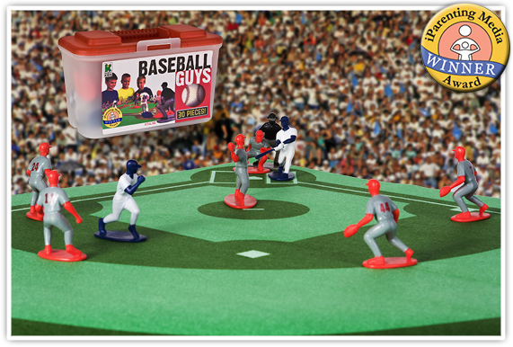
“The Baseball Study,” Recht & Leslie (1988)
Notes:
Recht and Leslie sought to answer exactly this question, by comparing the relative impact of reading ability to the impact of knowledge of a topic. They had students read a passage about baseball and then tested students comprehension of the passage.
“Effect of Prior Knowledge on Good and Poor Readers‘ Memory of Text” from Journal of Educational Psychology 1988, Vol. SO, No. 1, 16-20
Had 7th and 8th grade students read a short text about baseball and tested them for comprehension using:
Verbal retelling
Reenactment with figurines
Verbal summary
Rating ideas from the story in terms of importance.

Slide 24
“The Baseball Study,” Recht & Leslie (1988)
Compared reading comprehension for four categories of students:
High reading ability High knowledge of baseball | High reading ability Low knowledge of baseball
Low reading ability High knowledge of baseball | Low reading ability Low knowledge of baseball
Notes:
Quick check for understanding/following along. Ask people who they think was in each category (i.e. likely “jocks” in the low reading ability, high baseball knowledge group; “nerds” in the high ability low knowledge of baseball group).
The students in these 4 groups read a passage about baseball and then took a test of their comprehension. Ask participants to predict what % of questions on a reading comprehension test each category of student would get right. The best is for them to draw a grid on their paper and put an actual % of predicted questions correct in each quadrant. Tell them that the colors are so they can quickly match the group with the graphs on the next slide.
Technical Notes:
“The high-ability /high-knowledge cell had 10 boys and 6 girls; the high ability/low-knowledge cell had 3 boys and 13 girls; the low-ability/
high-knowledge cell had 12 boys and 4 girls; and the low-ability/low knowledge cell had 7 boys and 9 girls.”
High reading ability was defined as 70th percentile or higher on a standardized test of reading. Low reading ability was defined as 30th percentile or lower.
High knowledge of baseball was defined as 70th percentile or higher on a test of baseball knowledge. Low baseball ability was defined as 30th percentile or lower.

Slide 25
Notes:
After they predict percentages, show them this slide and give them a minute to take it in. They should notice that the low reading ability students with high knowledge (the “jocks”) outperformed the high reading ability students with low knowledge (the “nerds”). In addition there is little difference between the two high knowledge groups and the two low knowledge groups.
from pg. 18, table 1, Recht & Leslie 1988. (Qualitative Measure) Note: conversion from raw numbers to percentages achieved by dividing score by achieved by total possible score.
Frequently Asked Questions:
Is this study generalizable? Yes! In fact a European study replicated the finding exactly with students of a totally different background on the topic of soccer. Additional research has shown similar results on a wide variety of other topic and subject areas.
Is the impact here from knowledge or from interest? Knowledge. It’s hard to disentangle these variables, but a separate study using basketball was able to distinguish the two and found that the one that had the major impact was knowledge.
If knowledge is so important does this undermine the value of close reading? No. Close reading teaches students how to gain knowledge from text by attending to it carefully. But, as we will soon discuss, high volume reading of informational text is also necessary to build the base of knowledge and vocabulary necessary to succeed with close reading. This is a BOTH, AND type of question, not an either or.

Slide 27
Notes:
from pg. 18, table 1, Recht & Leslie 1988.

Slide 28
Findings
Knowledge of the topic had a MUCH bigger impact on comprehension than generalized reading ability did. (pg. 18)
With sufficient prior knowledge, “low ability” students performed similarly to higher ability students. (pg. 19) The difference in their performance was not statistically significant.
Notes:
The second bullet point here has a big implication for student scaffolds. By helping students build their knowledge, “low readers” can perform at levels similar to “high readers.”
Reference:
“With adequate prior knowledge, those students who are comprehending below the 30th percentile on the SRA [standardize reading assessment] are comparable with those above the 30th percentile in reenactment, verbal recall, and the ability to summarize text.” (pg. 19)

Slide 29
A student doesn’t have ONE level. Each student has MANY LEVELS depending on topic & knowledge.
Notes:
This research is in direct opposition to current instructional practice where we identify a reader by an F & P level, and if you are a level J then you read only level J books. But a level J reader on science passages may be a level T reader on explorers, if they have knowledge of that topic. By letting them read only level J texts we deny them access to more complex text that they could access and learn from on a topic on which they have knowledge.

Slide 30
Illustration: PARCC Redacted
Notes:
“We get this, but we ignore it. Ask teachers in an elevator what the most important areas to focus on to improve reading scores on the test. Listen to what they say. They never say vocabulary or building content knowledge. Everyone knows it’s important, but we don’t make it a focus. But if we could only see through our students eyes, we might re-prioritize.”

Slide 31
Imagine what it’s like to be a student with vocabulary and knowledge deficits…
…on test day.
Notes:
What comes next is a way of making the point vivid and memorable, and emphasizing not just the instructional value, but the moral urgency of helping kids develop the word and world knowledge they need. If we don’t help them rapidly gain vocab and knowledge, this is what they face every time they open a book or newspaper.

Slide 32
Notes:
This seems like a lot of black marks, and for some students it would be less. Think first of 3rd graders, and especially, struggling 3rd graders. Walk audience through the 1st paragraph, what was blacked out and why.
Inform them that the words blacked out are:
Including both academic tier 2 words (fascinating), and domain specific tier 3 words (glacier),
Also blacked out are topics or subject knowledge they don’t know about. (Alaska)
This based on the knowledge and vocab of the WEAKEST 3rd grade readers (those we talked about at the beginning); for others it would obviously be less, but it still just a milder version of this.

Slide 33
Notes:
Read some of this aloud filling in the blanks with the word “something.” It’s not necessary to do it as a full exercise, or to read through every slide. Just enough to get the point across.

Slide 35
Ready to give up yet?
Notes:
Many people talk about helping students reading stamina. How much MORE stamina does it take to read like this, than it would if you KNEW the words and topics that were blacked out.

Slide 36
What words or topics might be “blacked out” for our least knowledgeable readers?
Notes:
Next slides shows the “answer key” for the PARCC redacted activity. You can got through some of it so they can see what topics are words might draw a blank for most students. Even if they only feel that ½ of these words and topics would be unknown to students they can see how difficult it would be to comprehend.

Slide 38
When she was twenty-six, Eliza bought tickets to faraway Alaska. Few tourists had ever been there. Eliza wrote reports for the newspapers back home. She loved sharing the fascinating things she saw, such as huge glaciers, spouting whales, and the native people. Eliza even wrote a book – the first guidebook about Alaska.
When Eliza went back to Washington, it wasn’t long before she started thinking about traveling again. She decided to visit her older brother, who was working in Japan. Eliza sailed across the ocean.

Slide 39
In Japan she rode on trains, carriages, and bumpy rickshaws. She climbed mountains, ate strange foods, and visited ancient temples. Everything was so different! She studied Japanese art and learned to speak Japanese. She fell in love with Japan and its people.
Eliza especially loved Japanese gardens. Eliza’s favorite plants, by far were the Japanese cherry trees. Eliza called them “the most beautiful thing in the world.” Thousands of the trees were planted in parks and along the riverbanks. When they bloomed, the trees became clouds of pink blossoms. As the petals drifted down, it was like pink snowfall. The Japanese people loved the cherry trees as their national symbol. Crowds gathered for picnics under the trees. People wrote poems and painted pictures to honor those sakura.

Slide 40
When Eliza came back home, she wrote a book about Japan. She wanted to share her love of Japan with other Americans. She wanted the nations of Japan and America to be friends.
Even though she was always thinking about her next journey, Eliza loved coming home to Washington, D.C. She was proud of America’s growing capital and wanted it to look as beautiful as any city in the world.
She thought about the muddy land from a recent construction project in the swampy area around the riverbank. Eliza had a wonderful idea. She remembered the beautiful cherry trees in Japan. She thought, “That’s what Washington needs!”

Slide 41
Eliza told the man in charge of the Washington parks about the wonderful cherry trees. She showed him photographs that she had taken. She told him about her plan to plant hundreds of cherry trees down by the water. He said no. He believed they didn’t need any different kind of tree in Washington.
But Eliza knew that sometimes when you have a good idea, you have to keep trying. So she waited. When a new parks man was hired, she told him about her good idea. He, too, said no.

Slide 42
Eliza kept traveling. She also met with friends who loved to travel. Some of these friends had started the National Geographic Society. The society was for people who wanted to learn more about the world.
Eliza was the first woman to have an important job there, and she helped the society grow. She wrote many articles and books. Eliza made more trips to Japan, Alaska, and Europe and she explored India, China, Russia, and Java, an island of Indonesia.
Eliza also became a photographer. Not many women did that, either. She took pictures for the Smithsonian Institution and recorded people and places that Americans had never seen.
Notes:
*Note: A number of these words repeat throughout the text, especially “Japan”. Though repetition can at times increase students’ comprehension of a text if the repeated term is completely unfamiliar to students and the text does not explicitly or implicitly provide support for students to determine its meaning than the repetition makes comprehension even less likely.

Slide 43
We owe our students a better experience reading than this. We have to help them get the vocabulary and knowledge of the world they need to be able to read complex text.
Notes:
At this point take some time for them to discuss how seeing the passage like this connects to the reading comprehension questions provided with the passage. Let them discuss and really drive the point home about what kids need (reading strategies? or knowledge and vocab?), you can ask teachers to imagine being asked the questions about the passage they just read.
Specific details - What was one problem that Eliza experienced? Find evidence in the text to support your answer.
Inferences - What can you infer about the relationship between Japan and America from the response of the Japanese government to President Taft’s actions?
Main idea – How did Eliza eventually achieve her dream?
Does failure to answer these questions correctly mean that you don’t have mastery of the SKILLS required by the questions?
Why or why not?
What would you most need to answer these questions?
Discuss and share out.

Slide 44
What To Do About Vocabulary and Knowledge
“Building knowledge systematically in English language arts is like giving children various pieces of a puzzle in each grade that, over time, will form one big picture…”
Notes:
From the standards:
Building knowledge systematically in English language arts is like giving children various pieces of a puzzle in each grade that, over time, will form one big picture. At a curricular or instructional level, texts—within and across grade levels—need to be selected around topics or themes that systematically develop the knowledge base of students. Within a grade level, there should be an adequate number of titles on a single topic that would allow children to study that topic for a sustained period. The knowledge children have learned about particular topics in early grade levels should then be expanded and developed in subsequent grade levels to ensure an increasingly deeper understanding of these topics. Children in the upper elementary grades will generally be expected to read these texts independently and reflect on them in writing. However, children in the early grades (particularly K–2) should participate in rich, structured conversations with an adult in response to the written texts that are read aloud, orally comparing and contrasting as well as analyzing and synthesizing, in the manner called for by the Standards. Preparation for reading complex informational texts should begin at the very earliest elementary school grades. What follows is one example that uses domain specific nonfiction titles across grade levels to illustrate how curriculum designers and classroom teachers can infuse the English language arts block with rich, age-appropriate content knowledge and vocabulary in history/social studies, science, and the arts. Having students listen to informational read-alouds in the early grades helps lay the necessary foundation for students’ reading and understanding of increasingly complex texts on their own in subsequent grades

Slide 45
Letter from a Principal
“ We continue to struggle with the gaps in vocabulary development and background knowledge when students engage in close reading of a complex passage. We continue to model and assist students navigating through complex informational and fictional text, and hope that the efforts will help them carry skills to the next piece of text they encounter.”
Notes:
This attitude is common, understandable, and DEEPLY MISTAKEN.
SCHOOLS THAT ARE USING COMPLEX TEXT INFORMATIONAL AND LITERARY--- DOING CLOSE READING– TEACHING THE STANDARDS – DOING THE SHIFTS -- STUDENTS STILL STRUGGLE – WHY—GET RESPONSES AND LETTERS LIKE THIS FREQUENTLY
PROCESS ALL OF THIS 1) SUMMARIZE 2) AGREE/DISAGREE 3) WHAT TO DO

Slide 46
Close reading alone is NOT enough! In fact, done alone, it can INCREASE the GAP.
Notes:
Here is where we transition to explaining how all the pieces of literacy instruction fit together. The key point is BOTH/AND. Close reading and high-volume reading.
CLOSE READING IS NOT ENOUGH! Important to point out that some people have been throwing the baby out with the bath water, and completely abandoning high-volume, independent reading in favor of all close-reading, all the time.
Reading is very highly correlated to acquiring new vocab. Clear and compelling body of research, including Perfetti among many, many others, about correlation between pages read and words gained.
Knowledge gained through reading can help make up for differences in background knowledge. Not all students will have access to the same life experiences or language environment at home. But all students can gain knowledge of words and the world through reading. The fastest way to learn about new topics is to read about them. So helping students build knowledge through reading is an extremely important way of helping level the playing field and closing the achievement gap.

Slide 47
Let’s compare and contrast these two equally crucial components in an effective reading program, to see how they differ and each perform a uniquely valuable role.
Notes:
This is the concluding section, where we integrate what we already know about close reading and complex text with what we’ve just learned about knowledge and high-volume reading. Then we will transition this to concrete work of text sets.

Slide 48
Close Reading | Volume of Reading
Fewer pages | More pages
Grade-level complex text | Text at different levels of complexity
All students same text | Student or teacher choice of text
Teaches students to attend to text and to words | Rapidly builds knowledge & vocab
Notes:
Go through the chart comparing on each point.
1) One of the key points here is that with close reading, you go deep with a small amount, whereas in volume of reading you do a huge amount on a wide variety of topics. We simply CAN’T do close reading for everything because it takes too long. If you do only close reading, you won’t read enough.
2) NOTE: There are not only 2 categories. There is a broad spectrum. So really we need “close reading, volume of reading, and everything in between.”

Slide 49
Close Reading | Volume of Reading
Heavy support | Light support
Solely instructional | Guided or Independent
Exposes students to higher-level content | Builds knowledge of words, and the world
Gives all students access | Builds love of reading

Slide 50
Now that we are starting to put together the pieces, let’s focus in on volume of reading.

Slide 51
Students cannot build knowledge and vocabulary without a high volume of reading.
Most words are learned through reading or being read to.
Building knowledge helps level the playing field for students.

Slide 52
Not all high-volume reading is equally effective
Research by Landauer and Dumais into vocabulary acquisition shows that students acquire vocabulary up to four times faster when they read a series of related texts.
Reading a number of texts within a topic grows knowledge and vocabulary far faster than any other approach
Notes:
Contrast this to the typical way we do business where we skip around from topic to topic, plants today, tree mammal tomorrow, the colonies the day after. Instead we need to spend time reading several texts within the same topic in order to build knowledge and vocabulary faster. With the huge volume of words and huge bodies of knowledge that students need to learn, we can’t afford to not use the most effective, fastest way to gain this knowledge.
The research referenced here is what led to the creation of the idea of text sets: a thoughtfully sequenced series of texts designed to build knowledge and vocabulary.

Slide 53
When in the School Day Can These Text Sets Be Used?
Social Studies
Science
Guided Reading
Homework/Classwork
Notes:
I THINK THIS SLIDE NEEDS TO GO. IT CERTAINLY DOESN’T MAKE SENSE AS A CONCLUDING POINT. WE NEED A CONCLUDING SLIDE THAT TRANSITIONS REALLY WELL TO TEXT SETS.

Slide 54
On to The Text Set Project!

Slide 55
Help with Vocabulary Instruction
Vocabulary and The Common Core
by David Liben
(research and practical exercises)
http://achievethecore.org/page/974/vocabulary-and-the-common-core
Notes:
These are supplemental resource slides, for reference not to be reviewed in the presentation.

Slide 56
Help with Guided Reading
‘Both, And’ paper by David & Meredith Liben
http://bit.ly/1oWZ7ai
Notes:
These are supplemental resource slides, for reference not to be reviewed in the presentation.

Slide 57
On to the Text Set Project!

Slide 58
What is an Expert Pack?
Model Expert Pack: Earth’s Precious Resource

Slide 59
Text Sets
Discuss with your colleagues: what do you know about text sets?
Notes:
Allow a few minutes of table talk for participants to share prior understanding text sets in general.
After discussion, acknowledge that there are many different design and implementation approaches to text sets that all have their merits.
This training is designed for a very specific approach to text sets called, Expert Packs.

Slide 60
Expert Packs: The Specs
Collection of resources organized for students to build knowledge about a specific topic
Glossary of terms to help students access challenging vocabulary
Suggested activities to help students capture and express their learning
Notes:
Collection of resources (books, articles, websites, videos, etc.) organized into an detailed annotated bibliography.
Glossary of terms from the various resources.
Suggested student activities called Learning Worth Remembering

Slide 61
1. Resources
Variety of resources
Sequenced to create a coherent and gradual learning process
Generally beginning with lower reading levels (quantitative and qualitative measures) and moving to more complex levels
Support students’ ability to read the next selection (mostly) independently
Students become ‘experts’ on the topic

Slide 62
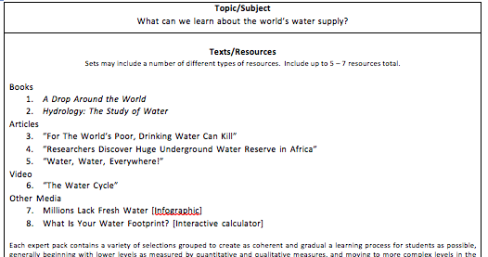
Earth’s Precious Resource
Suggested Sequence
“For the World’s Poor, Drinking Water Can Kill”
“Millions Lack Safe Water”
“The Water Cycle”
“Water, Water, Everywhere!”
Hydrology: The Study of Water
A Drop Around the World
“Researchers Discover Huge Underground Water Reserve in Africa”
“What is Your Water Footprint?”
Notes:
Direct participants to pg. 8 – 12 in Participants Handout
On the left the resources are organized by type
On the right the same resources are organized in the specific sequence in which they should be read by the students. Designed to create a coherent and gradual learning process, both in terms of text complexity and building of knowledge on the topic
Participants may refer to the first 2 – 3 pages of Earth’s Precious Resource AB

Slide 63
2. Glossary of Terms
Help students access challenging vocabulary
Which words?
Tier 2 (academic vocabulary)
Essential to text
Likely to appear in future texts
Tier 3 (domain-specific)
Key terms essential to understanding the text
May also be defined in the text (footnote, text box, etc.)

Slide 64
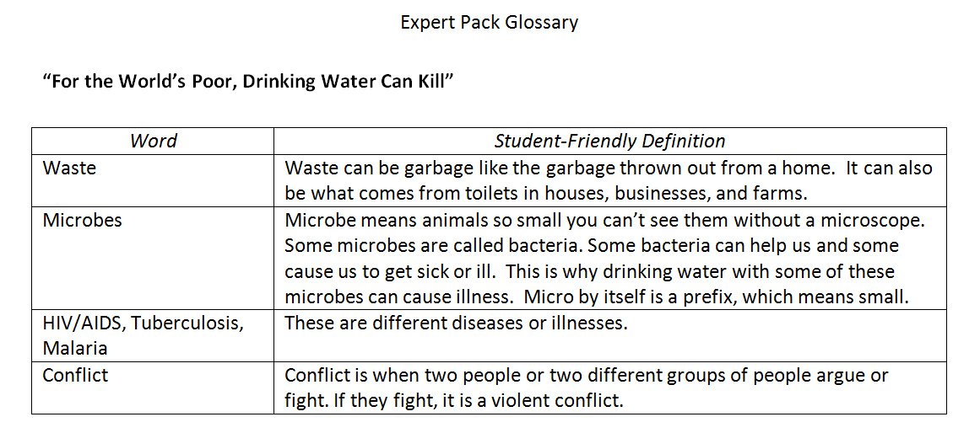
Earth’s Precious Resource
Notes:
Direct participants to pg. 20 – 24 in Participants Handout
Participants may refer to Earth’s Precious Resource glossary for further examples.

Slide 65
3. Suggested Activities
Learning Worth Remembering
Student accountability – Is this work worth doing?
“Light-touch approach” for teachers and students. Can this be done with ease and (mostly) independence?
Notes:
We have a template with a variety of suggested activities for each and all resources.
We will look at this in detail later in the training.

Slide 66
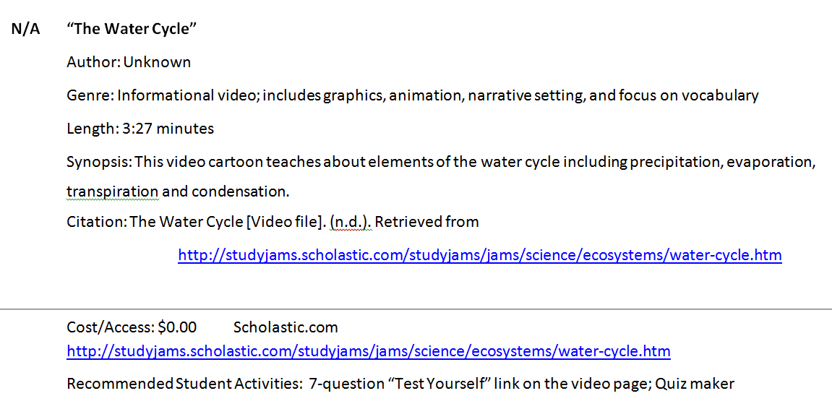
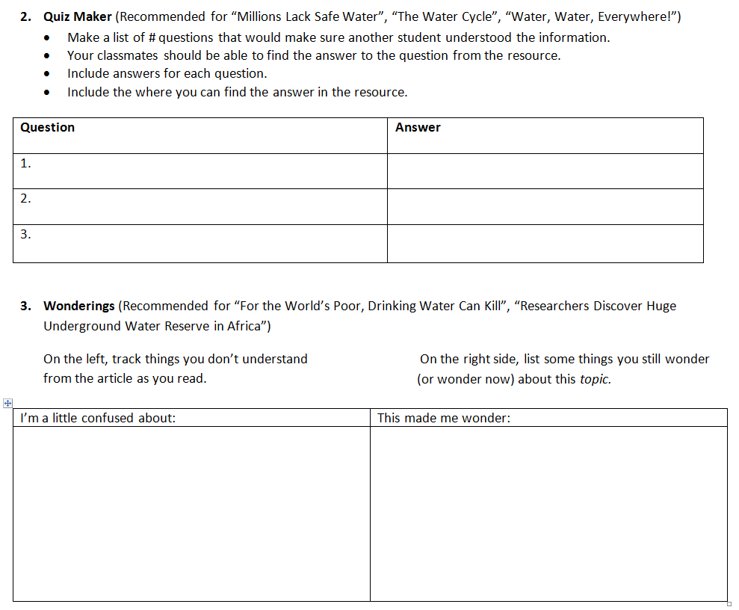
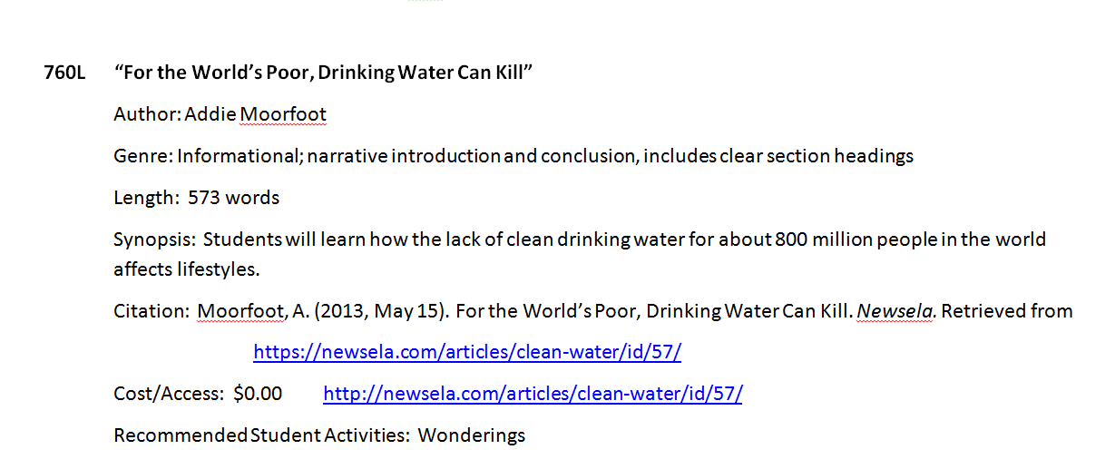
Earth’s Precious Resource
Notes:
Direct participants to pg. 15 – 19 in Participants Handout
Participants may refer to the Earth’s Precious Resource LWR pages.

Slide 67
You Try! Earth’s Precious Resource
Skim through the resources. Follow the suggested sequence.
Use the glossary.
Try one activity from the Learning Worth Remembering activities.
Be prepared to discuss:
What will students learn from this Expert Pack?
How will students learn from this Expert Pack?
Notes:
Direct participant to pg. 8 – 24 in Participants Handout
Allow 20 – 30 minutes for participants to read the sample Expert Pack and experience the learning sequence.
Afterwards, lead discussion around the two questions:
What will students learn from this Expert Pack?
How will students learn from this Expert Pack?
Encourage participants to be as specific as possible and to reference particular details from the Earth’s Precious Resource Expert Pack

Slide 68
“The intuitive mind is a sacred gift and the rational mind is a faithful servant. We have created a society that honors the servant and has forgotten the gift.”
- Albert Einstein
Notes:
Expert Packs attempt to honor the natural intuitive and inquisitive minds of students.

Slide 69
Text Set Project on Edmodo
Make a teacher account at www.edmodo.com
On the left side of home screen, it will say “Groups” under your name and picture. Click on the + next to “Groups” and choose “Join”.
Type in the group code: sma265
From your home screen, you should now see “Text Set Project” listed under “Groups”. Click on this tab.
Choose “Folders” from the left side of your screen.

Slide 70
How Can Expert Packs Be Used?
Pilot Project Tips: Earth’s Precious Resource
Notes:
45 minutes total for this portion
Big Idea: Using an Expert Pack to build knowledge and vocabulary requires a different set of instructional moves.
Details:
At the first Text Set Project Training, participants repeated asked, where does this fit in the day? How can these packs be used?
To begin to answer that question, and to see what happened in real 4th and 5th grade classrooms, we began a pilot project with the Earth’s Precious Resource pack.
Facilitator Note: There is a NOTETAKER for this section of the training. It is page ___ in your handout packet. This sheet lists content areas, potential purposes for using Expert Packs and levels of support teachers could provide. There is also a column for notes you might want to take as you discuss the use of expert packs with your tablemates.

Slide 71
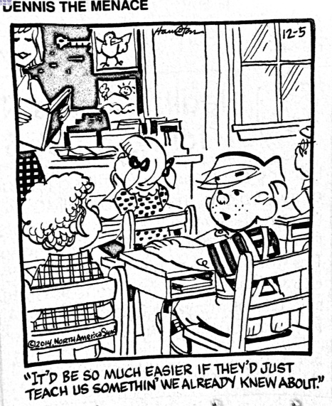
Notes:
Big Idea: We all can relate to this!
Details:
Though this is just a comic, this is the idea behind text sets. To take what students already know something about and build on it.

Slide 72
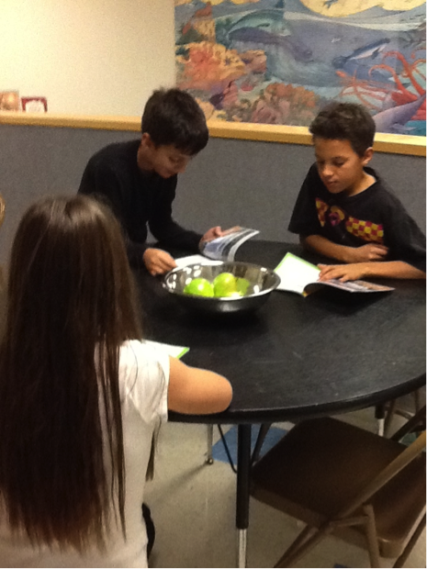
Inquiry
How can we design and integrate expert packs into curriculum to build student vocabulary, knowledge and capacity to read independently?
Notes:
Big Idea: Using expert packs to build knowledge, vocabulary and the capacity to read independently is a new idea and will require new instructional moves. This essential question drives our work forward.
Details:
You heard earlier that this work is not close reading. To accomplish a wide volume of reading, the students must be working as independently as possible so they get as much practice reading and exposure to words as can be accomplished in a set period of time.
A text set might support, extend, build background for units of study, but different than work that is fully guided by the teacher, the reading in expert packs is designed to be done by the students.
So how did our pilot teachers use the expert packs and what did they learn? What advice did they find and what advice do they have to offer?

Slide 73
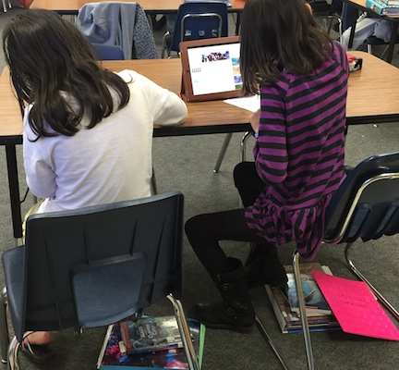
The Pilot Project: Earth’s Precious Resource
7 classes – Nevada and Vermont
Range of student abilities
Notes:
Big Idea: this was one pilot project in 4th and 5th grade classrooms. Following the first Text Set Project Training, 7 classroom teachers, 6 coaches, and a principal volunteered to try out the Expert Pack and reflect on what happened in the classroom.
Details:
The classrooms were diverse: 2 Accelerated 4/5 classes, 1 low SES general ed (28 students), 4 mid SES 4th grades
None of the teachers had attended the training but the coaches and principal had attended and supported the teachers with resources and ideas.

Slide 74
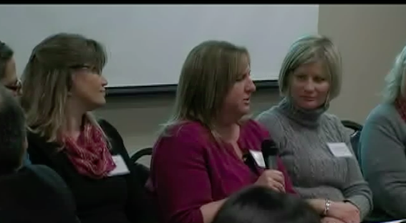
Text Set Project Panel (see video)
Notes:
Big Idea: Some of the pilot teachers were on hand for the Text Set training in Clark County and agreed to sit on a panel Here are some of the highlights.
Details:
The Text Set Project Panel video is located here: https://vimeo.com/132680916
Download the video to your computer to ensure the best quality playback.
Refer participants to the notetaker titled Using Text Sets in the packet on pages 25 -26.
Encourage them to take notes for discussion.
Play the video through to 9:50. Pause for discussion: What reasonated with you?
Play the rest of the video and move to the next slide.

Slide 75
Group Discussion
Consider the ideas listed on the notetaker and the thoughts presented by the panelists.
How could you use text sets in your setting? Be ready to share some ideas from your table.
Notes:
Big Idea:
Allow table groups 5-8 minutes to discuss ideas.
Share out a few whole group.
Summarize: Text sets are highly versatile and may be useful in a variety of settings. The purpose behind the sets will always be to build knowledge, vocabulary and the capacity to read independently. Some side benefits, as you heard from the panel, their use may be highly motivating to students and foster their love of reading, too!

Slide 76
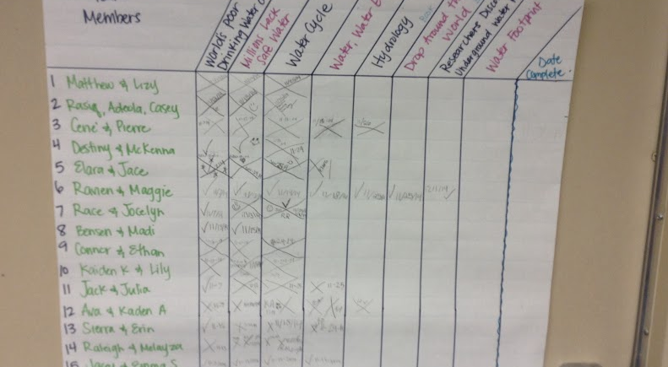
Management
“Now that the routines are set, if there was another set to do with this same class, I think they would have a lot more independence.”
Notes:
Big Idea: The management of expert packs should be carefully considered and planned the first time students are introduced to them. The power of creating routines was mentioned by all participants.
Details:
All of the pilot teachers found that students were increasingly able to complete the rolling knowledge or vocabulary journal as the expert pack reading went on.
Most of them felt that now that the students were familiar with the learning worth remembering activities and the expectations, they could engage with the next pack more independently.
There were questions about accountability, e.g, How do I grade the work?; What if students struggled to write a good question- should I take time and teach that?
Teachers made notebook organizers and trackers for the EP. These are available if you are interested.

Slide 77
Students
“There are these little tiny bugs called microbes. The water is crystal clear, so he may not know it is polluted.”
“I went home and got on water.org last night.”
“I remember from the last article people are doing things to prevent more people dying like building wells.”
Notes:
Big Idea: We heard from some of the teachers. What were the kids saying? These quotes were taken from some student writing or discussion.

Slide 78
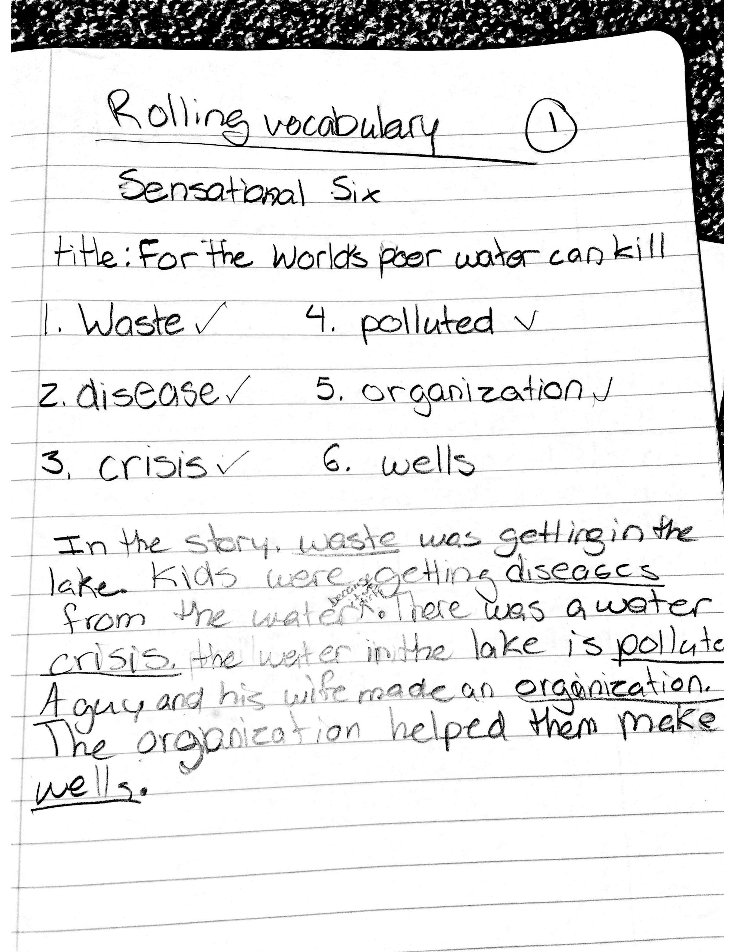
Sample Student Work

Slide 79
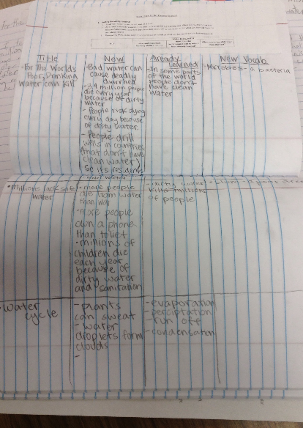
Notes:
Big Idea: A photo of one student’s rolling knowledge journal.

Slide 80
Sample Student Work
Use only 8 words to take notes; it has to be in your own words.
Hydrologists study runoff and overflow to warn people of floods.
People build aqueducts to get water to people.
Throughout history, hydrologists found ways to control water.
Notes:
Big Idea: Students use the vocabulary of the texts using a summarizing strategy they learned called 8-word notes.

Slide 81
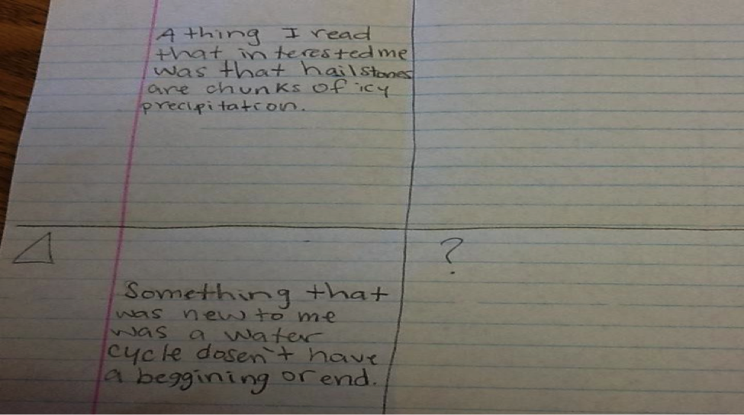
Sample work
Notes:
Big Idea: Students decide what learning to record. This is a great formative information about what they are focusing on, what meaning they are making, what confuses them.

Slide 82
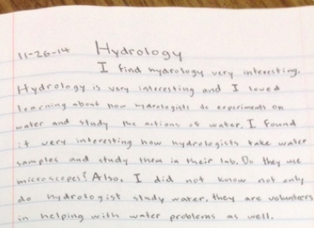
Pun
Notes:
Big idea: There is a pun in this piece.
In the last sentence:
Also, I did not know not only do hydrologists study water, they are volunteers in helping with water problems as well!

Slide 83
Resources
All of the resources and reflections collected during the pilot project are available in the folders on Edmodo.
Cschmidt@studentsachieve.net

